Slide 1

Minimum Cost Spanning Trees: Prims and Kruskal Algorithm
Data Structure | Graph
Course: Data Structure | Chapter: Graph | Bachelor of Engineering
DISCOVER · LEARN · EMPOWER
Notes:
Welcome students to this advanced session on Graph algorithms. Today we focus specifically on constructing Minimum Cost Spanning Trees using Prim's and Kruskal's methods. These algorithms are critical for optimizing network designs in real-world engineering scenarios.

Slide 2
Course Outcomes
SLIDE 2 / 14
Course Outcome
CO | BT LEVEL | DESCRIPTION
CO1 | BT1 | Understand and apply basic data structures, algorithms, complexity analysis, ADTs, arrays and linked lists.
CO2 | BT2 | Apply and implement stacks and queues in problem-solving.
CO3 | BT3 | Analyse and apply searching, sorting, and hashing techniques.
CO4 | BT4 | Construct and apply tree structures and traversal techniques.
CO5 | BT5 | Represent and solve graph problems using DFS, BFS, and graph algorithms.
Chandigarh University
2 / 14
Notes:
These outcomes directly map to our ability to build tree structures and solve complex graph problems. By mastering these algorithms, you will satisfy the requirement to apply traversal techniques and solve optimization problems efficiently.

Slide 3
Learning Objectives
SLIDE 3 / 14
Learning Outcomes
1
Analyze the fundamental properties of Minimum Spanning Trees in weighted graphs.
2
Evaluate the greedy strategy employed by Prim's algorithm for connectivity.
3
Differentiate the edge-selection logic used in Kruskal's algorithm versus Prim's.
4
Construct a complete MST for a given weighted graph using both methods.
5
Critique the time complexity and space requirements of each algorithm.
Chandigarh University
3 / 14
Notes:
By the end of this lecture, you will not just memorize steps but analyze why these greedy approaches work. We will evaluate how Prim's grows a tree from a node while Kruskal's builds a forest. You will be able to construct a complete MST for any given weighted graph.

Slide 4
Lecture
SLIDE 4 / 14
Definition of Minimum Spanning Tree
1
An MST connects all vertices in a connected graph with minimum total edge weight.
2
The resulting structure must be a tree containing no cycles or loops.
3
For a graph with V vertices, the MST contains exactly V minus 1 edges.
4
If edge weights are unique, the MST is guaranteed to be unique.
5
Multiple MSTs exist if the graph contains edges with identical weights.
6
The primary goal is minimizing the sum of weights of all selected edges.
Minimum Spanning Tree: Algorithms Explained with Examples
Chandigarh University
4 / 14
Notes:
Think of an MST as the cheapest way to connect all cities with roads without creating any loops. If you have five cities, you need exactly four roads to connect them all. The total cost of these roads must be the lowest possible sum.

Slide 5

Prim's Algorithm
SLIDE 5 / 14
Core Concept
1
Prim's algorithm grows a single tree by adding the cheapest edge from the tree.
2
It starts from an arbitrary source vertex and expands outward to neighbors.
3
The algorithm maintains a set of vertices already included in the MST.
4
It uses a priority queue to efficiently select the minimum weight edge.
5
This approach ensures connectivity is maintained at every step of the process.
6
It is conceptually similar to Dijkstra's shortest path algorithm logic.
Source: cdn.atomisystems.com
Chandigarh University
5 / 14
Notes:
Imagine Prim's algorithm as a fire spreading from a single starting point. It always chooses the nearest unburnt neighbor to expand the fire. This ensures that at every step, we have a connected component that is growing.

Slide 6
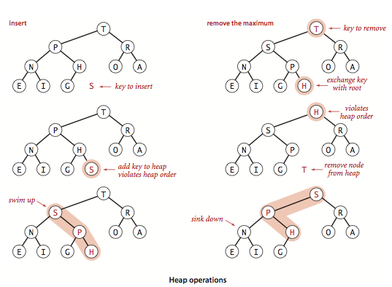
Prim's Algorithm
SLIDE 6 / 14
Step-by-Step Logic
1
Initialize a key value for all vertices to infinity except the source.
2
Set the source vertex key to zero to start the expansion process.
3
Insert all vertices into a priority queue based on their current key values.
4
Extract the vertex with the minimum key value from the priority queue.
5
Update the key values of adjacent vertices if a cheaper edge is found.
6
Repeat until all vertices are included in the growing Minimum Spanning Tree.
Source: algs4.cs.princeton.edu
Chandigarh University
6 / 14
Notes:
We start by setting the source cost to zero and all others to infinity. We pick the cheapest node, then check its neighbors. If a neighbor can be reached cheaper through the current node, we update its cost. This greedy choice guarantees the optimal solution.

Slide 7
Kruskal's Algorithm
SLIDE 7 / 14
Core Concept
1
Kruskal's algorithm builds a forest of trees that eventually merge into one.
2
It sorts all edges in the graph in non-decreasing order of weights.
3
It iteratively adds the smallest edge if it does not form a cycle.
4
The algorithm uses a Disjoint Set Union data structure for cycle detection.
5
It treats the graph as a collection of separate components initially.
6
This approach is ideal for sparse graphs with fewer edges than vertices.
Chandigarh University
7 / 14
Notes:
Unlike Prim's, Kruskal's does not grow from a single point. It looks at all roads in the country and picks the cheapest one first. If that road connects two different towns, it builds it; otherwise, it skips it to avoid a loop.

Slide 8
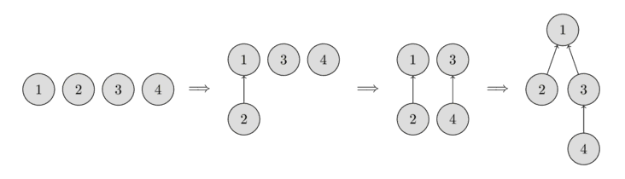
Kruskal's Algorithm
SLIDE 8 / 14
Cycle Detection
1
A cycle forms if an edge connects two vertices already in the same set.
2
The Union-Find data structure tracks which vertices belong to which component.
3
The Find operation determines the representative of the set for a vertex.
4
The Union operation merges two sets when an edge connects them.
5
Checking for cycles ensures the final structure remains a valid tree.
6
This mechanism prevents the formation of loops during the edge selection process.
Source: cp-algorithms.com
Chandigarh University
8 / 14
Notes:
We use a special tool called Union-Find to track which towns are already connected. Before adding a road, we check if the two towns are already in the same group. If they are, adding the road would create a loop, so we discard it.

Slide 9
Worked Example
SLIDE 9 / 14
Graph Setup
GOVERNING EQUATION
The edges have weights: AB=4, AC=2, BC=1, CD=3, DE=5, CE=6
1
Consider a graph with 5 vertices labeled A, B, C, D, and E.
2
We aim to find the Minimum Spanning Tree for this specific configuration.
3
Total vertices V equals 5, so the MST will contain exactly 4 edges.
4
The sum of weights for the selected edges must be minimized.
5
We will solve this using both Prim's and Kruskal's algorithms for comparison.
Chandigarh University
9 / 14
Notes:
Let's look at a concrete example with five nodes. We have edges connecting them with specific costs like 1, 2, 3, 4, 5, and 6. Our goal is to pick four edges that connect everyone with the lowest total cost. This setup will help us compare both algorithms.

Slide 10
Worked Example
SLIDE 10 / 14
Prim's Execution
GOVERNING EQUATION
Select A, update neighbors: B=4, C=2. Select C (min key)
TOTAL WEIGHT CALCULATION
2 + 1 + 3 + 5 equals 11.
• Start at vertex A with key 0 and all others as infinity.
• From C, update neighbors: B=1 (cheaper), D=3. Select B.
• From B, no cheaper updates. From D, update E=5. Select D.
• Finally select E. The selected edges are AC, CB, CD, DE.
Chandigarh University
10 / 14
Notes:
Starting at A, we see C is closest at cost 2. From C, we find B is only 1 away, which is cheaper than the direct path from A. We continue this greedy expansion until all nodes are connected. The total cost comes out to 11.

Slide 11
Worked Example
SLIDE 11 / 14
Kruskal's Execution
SORT ALL EDGES BY WEIGHT
BC(1), AC(2), CD(3), AB(4), DE(5), CE(6).
TOTAL WEIGHT CALCULATION
1 + 2 + 3 + 5 equals 11.
• Select BC (weight 1). Sets: {B,C}, {A}, {D}, {E}.
• Select AC (weight 2). Sets: {A,B,C}, {D}, {E}.
• Select CD (weight 3). Sets: {A,B,C,D}, {E}.
• Select DE (weight 5). Sets: {A,B,C,D,E}. All connected.
Chandigarh University
11 / 14
Notes:
We sort the edges and pick the smallest. BC is 1, then AC is 2. Next is CD at 3. We skip AB because A and B are already connected. Finally, we add DE at 5 to connect the last node. The total cost is also 11.

Slide 12
Lecture
SLIDE 12 / 14
Common Pitfalls and Errors
1
Failing to check for cycles in Kruskal's algorithm leads to invalid trees.
2
Using a simple array instead of a priority queue slows Prim's significantly.
3
Starting Prim's from a disconnected vertex results in an incomplete tree.
4
Ignoring negative edge weights can cause logic errors in greedy selection.
5
Incorrectly implementing Union-Find leads to O(V²) complexity instead of O(E log V).
6
Assuming the MST is unique when multiple edges have identical weights.
Chandigarh University
12 / 14
Notes:
A common mistake is forgetting to check for cycles in Kruskal's, which creates a loop. In Prim's, using a slow priority queue makes the algorithm inefficient for large graphs. Always verify your cycle detection logic and ensure you handle equal weights correctly.

Slide 13
Lecture
SLIDE 13 / 14
Key Takeaways
1
Both Prim's and Kruskal's use greedy strategies to find the optimal MST.
2
Prim's grows a single tree from a source vertex using a priority queue.
3
Kruskal's builds a forest by adding edges in sorted order without cycles.
4
Prim's is efficient for dense graphs while Kruskal's suits sparse graphs.
5
The total weight of the MST is unique even if the tree structure varies.
Chandigarh University
13 / 14
Notes:
Remember that both algorithms guarantee the minimum total weight. Prim's is like a growing tree, while Kruskal's is like sorting and picking. Choose Prim's for dense networks and Kruskal's for sparse ones. The total cost will always be the same.

Slide 14
Lecture
SLIDE 14 / 14
References
DATA STRUCTURES
A Pseudocode Approach with C — Gilberg, Forouzan
• Data Structures — Lipschutz
• Data Structure Using C — AK Sharma
• C and Data structure — P. S. Deshpandey
Chandigarh University
14 / 14
Notes:
These four textbooks provide comprehensive coverage of graph algorithms and data structures. I recommend Gilberg and Forouzan for pseudocode clarity and Lipschutz for concise explanations. Please refer to Sharma and Deshpandey for C-specific implementations.

